Slide 1

Software Development Project Java III Course Software
420-517-DW
With Ken Fogel

Slide 2
System Preparation
Windows
Add two folders named dev and devapp to your system
Windows: recommended off of a root such as C:\dev and C:\devapp
Mac/Linux
Usually installers do not give you the option of selecting the location of the installation
Accept the default location even if given the option to select a folder
For all operating systems any location can work but there must NOT be any spaces in the path

Slide 3
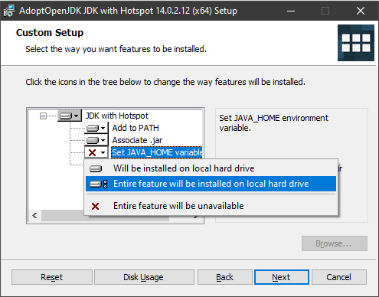
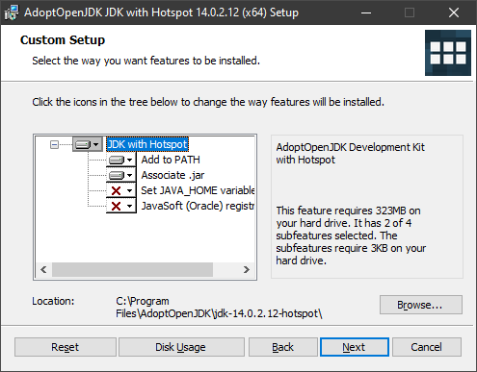
Java
Java 14 for 420-517 – Latest version
Java 11 for 420-625 – LTS (long term support) version
Download from https://adoptopenjdk.net/
Only for Java 14 do you set JAVA_HOME

Slide 4
Apache NetBeans 12
Download it from https://netbeans.apache.org/download/nb120/nb120.html
Mac/Linux
Accept the default location for the installation
Windows
Install into the devapp folder
Change C:\Program Files\NetBeans-12.0
to C:\devapp\NetBeans-12.0
Adjust accordingly if devapp is not on Drive C.
All other choices are the default

Slide 5
Apache NetBeans 12
Before you run NetBeans for the first time in Windows there are two configuration changes I recommend (not required for Mac/Linux)
There are not required and are optional
Open the text file
C:\devapp\NetBeans-12.0\netbeans\etc\netbeans.conf
Replace
netbeans_default_userdir="${DEFAULT_USERDIR_ROOT}/12.0"
netbeans_default_cachedir="${DEFAULT_CACHEDIR_ROOT}/12.0"
With
netbeans_default_userdir= "C:\devapp\NB\USERDIR\12.0"
netbeans_default_cachedir="C:\devapp\NB\CACHEDIR\12.0"

Slide 6
Apache NetBeans 12
Open the text file
C:\devapp\NetBeans-12.0\
netbeans\java\maven\conf\
settings.xml
Locate the following line that is in a comment:
<localRepository>/path/to/local/repo
</localRepository>
Change it to
<localRepository>
C:/devapp/.m2/repository
</localRepository>

Slide 7
Gluon SceneBuilder
Download from https://gluonhq.com/products/scene-builder/#download
Mac/Linux
Accept all defaults for the installation
Windows
Accept all defaults for the installation
Move the SceneBuilder folder from C:\Program Files\ to C:\devapp\

Slide 8
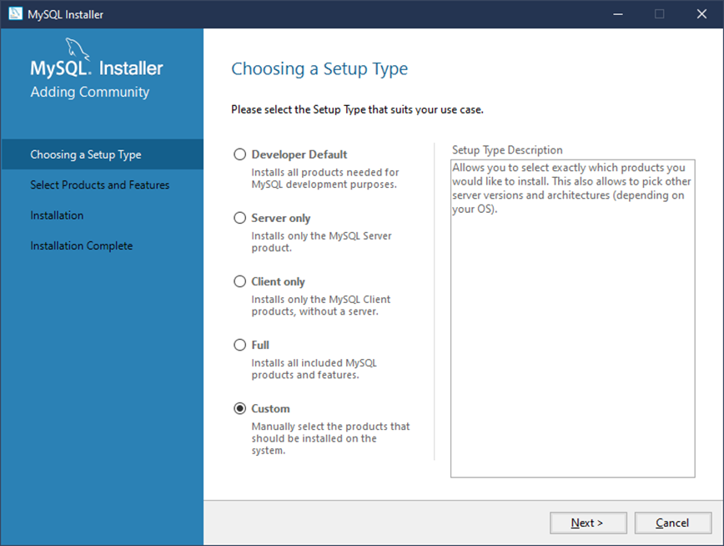
MySQL
Download and install the Community Server from https://dev.mysql.com/downloads/installer/
Choose the Custom setup type

Slide 9
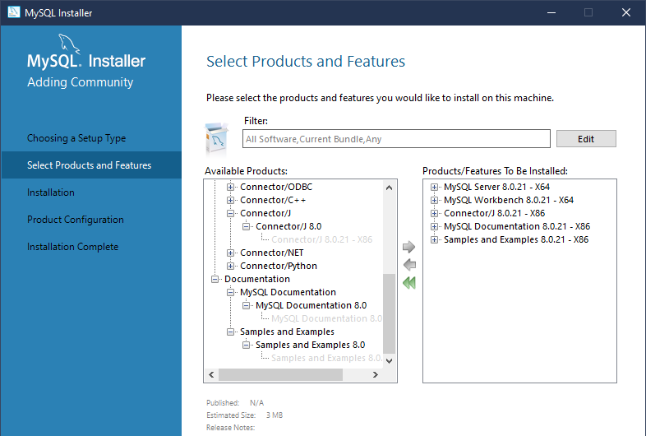
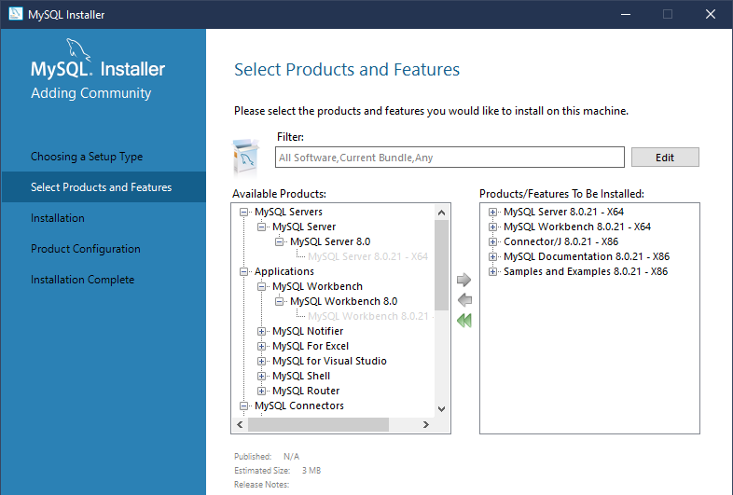
MySQL
Now you must select which components of MySQL you need.

Slide 10
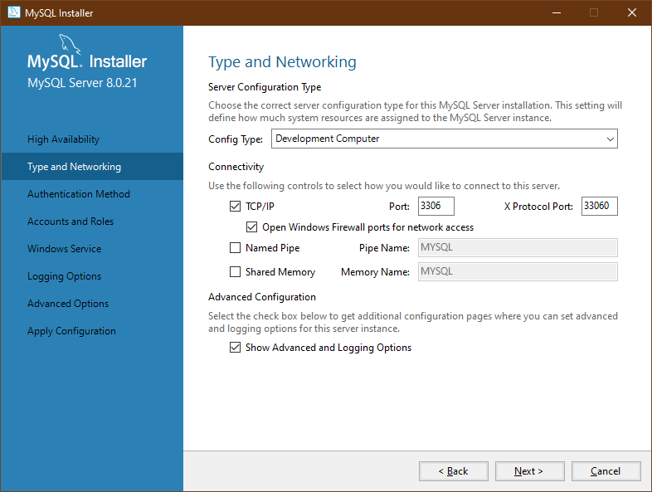
MySQL
After all the components are installed you need to configure MySQL
Accept all defaults until you get to this dialog where you will check Show Advanced and Logging Options

Slide 11
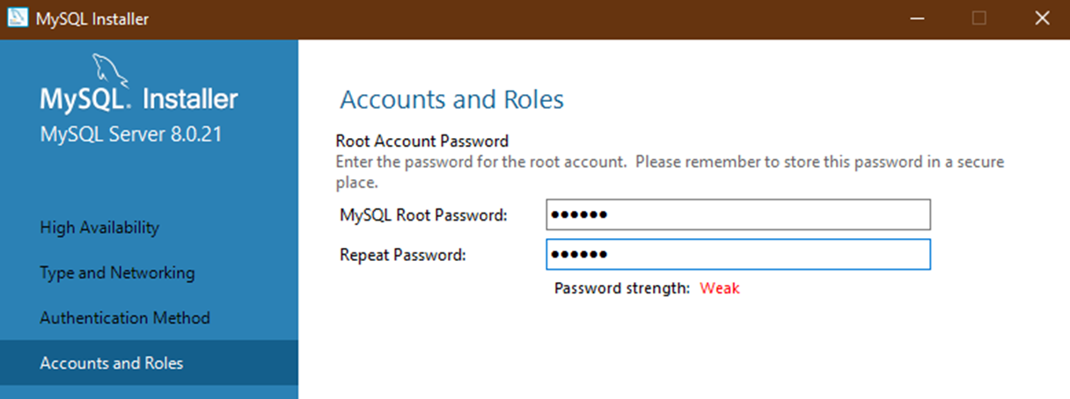
MySQL
Accept all defaults until this dialog
While a poor choice from the perspective of security, please use dawson as the root password
This will ensure that when I run your code we will have the same root credentials

Slide 12
MySQL
Windows
Most efficient way to run MySQL is as a service
Uncheck Start the MySQL Service at System Startup
You will start and stop MySQL from the Windows Services app

Slide 13
MySQL
Mac
You should have a MySQL choice under System Preferences
Here is where you can start or stop MySQL
MySQL
I am unsure of how to start and stop MySQL other than from the command line
You can accept all default settings until the installation is complete from this point

Slide 14
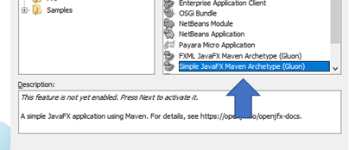
Testing the Installation
Ensure that the MySQL service is running
Run NetBeans
Once running you need to create a JavaFX project
This will automatically configure NetBeans
Go to the File menu and select New Project
Select Simple JavaFX Maven Archetype

Slide 15
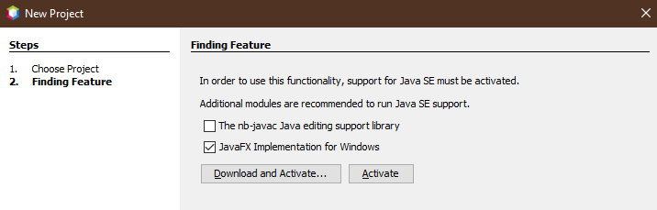
Testing the Installation
You should now see the following dialog
If The nb-javac Java editing support library is checked off then uncheck it
Only JavaFX Implementation for Windows or the equivalent for Mac/Linux should be checked
Click on Download and Activate…

Slide 16
Testing the Installation
Once JavaFX is setup you will be brought to the new project dialog
Change the Project Location to C:\dev\420-517
Change nothing else and click on Finish
You will see in the console window of NetBeans messages that state that files are being downloaded
A simple Maven based project is now created
Right mouse click on the project name mavenproject1 and select Run
After downloading some additional files from the Maven repository you should see:

Slide 17
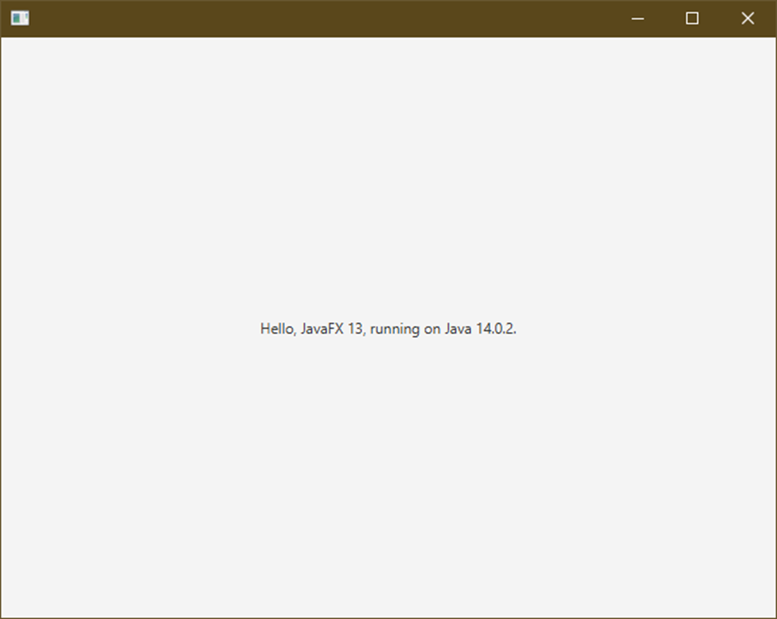
Testing the Installation
If you see this window then the installation is complete for now
We will test connecting to MySQL and SceneBuilder when we need to use them
You are now ready for the warm up exercise

